Slide 1
{project} Tech DD report
Disclaimer - This is a due diligence report ("CAST Report") on software health and risks based on the information provided to CAST by the Client. The CAST Report is not intended to replace the full due diligence to be performed by Client, its affiliates and any underwriters using the CAST Report. Any party is responsible for its own full due diligence and should not rely solely on the CAST Report for its decisions.
Chakra Yarlagadda, SVP, Tech Partnerships, M&A Manish Sharma, M&A Team Lead, CAST Services Matthieu Mabyre, Lead Assessor & Technology SME, CAST Services
{month} {year}

Slide 2

Executive Summary
Results for {project}
Next Steps
Appendices
Agenda

Slide 3
Overview – The {project} applications have {show_stopper_flg} show-stopper issues, red flag issues can be remediated with {hml_cost_flag} cost
{project} applications | App Name | App Rating | Vulnerability (open-source components) | Remediation Action | $ estimate*
 | {app#_name} |  | {app#_crit_sec_tot} critical security vulnerabilities, {app#_high_lic_tot} high-risk license profiles | {app#_summary_vio_cnt} high priority issues for {app#_summary_bus_txt} | ${app#_summary_cost}K ({app#_summary_eff} person-days)
 | {app2_name} |  | {app2_crit_sec_tot} critical security vulnerabilities, {app2_high_lic_tot} high-risk license profiles | {app2_summary_vio_cnt} high priority issues for {app2_summary_bus_txt} | ${app2_summary_cost}K ({app2_summary_eff} person-days)
 | {app3_name} |  | {app3_crit_sec_tot} critical security vulnerabilities, {app3_high_lic_tot} high-risk license profiles | {app3_summary_vio_cnt} high priority issues for {app3_summary_bus_txt} | ${app3_summary_cost}K ({app3_summary_eff} person-days)
 | {app4_name} |  | {app4_crit_sec_tot} critical security vulnerabilities, {app4_high_lic_tot} high-risk license profiles | {app4_summary_vio_cnt} high priority issues for {app4_summary_bus_txt} | ${app4_summary_cost}K ({app4_summary_eff} person-days)
 | {app5_name} |  | {app5_crit_sec_tot} critical security vulnerabilities, {app5_high_lic_tot} high-risk license profiles | {app5_summary_vio_cnt} high priority issues for {app5_summary_bus_txt} | ${app5_summary_cost}K ({app5_summary_eff} person-days)
 | {app6_name} |  | {app6_crit_sec_tot} critical security vulnerabilities, {app6_high_lic_tot} high-risk license profiles | {app6_summary_vio_cnt} high priority issues for {app6_summary_bus_txt} | ${app6_summary_cost}K ({app6_summary_eff} person-days)
 | {app7_name} |  | {app7_crit_sec_tot} critical security vulnerabilities, {app7_high_lic_tot} high-risk license profiles | {app7_summary_vio_cnt} high priority issues for {app7_summary_bus_txt} | ${app7_summary_cost}K ({app7_summary_eff} person-days)
 | {app8_name} |  | {app8_crit_sec_tot} critical security vulnerabilities, {app8_high_lic_tot} high-risk license profiles | {app8_summary_vio_cnt} high priority issues for {app8_summary_bus_txt} | ${app8_summary_cost}K ({app8_summary_eff} person-days)
 | {app9_name} |  | {app9_crit_sec_tot} critical security vulnerabilities, {app9_high_lic_tot} high-risk license profiles | {app9_summary_vio_cnt} high priority issues for {app9_summary_bus_txt} | ${app9_summary_cost}K ({app9_summary_eff} person-days)
 | {app10_name} |  | {app10_crit_sec_tot} critical security vulnerabilities, {app10_high_lic_tot} high-risk license profiles | {app10_summary_vio_cnt} high priority issues for {app10_summary_bus_txt} | ${app10_summary_cost}K ({app10_summary_eff} person-days)
Total $estimate for the {project} applications: ${summary_total_cost}K max
Notes –
* Day-rate used for cost calculation - ${daily_rate}/day
High-risk License profiles are not included in the total cost

Slide 4
Assessment Approach @ {company}
Automated, objective assessment of the structural and architectural quality of applications to be acquired.
Answers for today
What is the application’s current state of health according to CAST Software Intelligence Products ?
Which areas of the application are critical to fix, and which ones can be improved quickly ? How big is the effort to fix identified issues ?
What is the critical risk associated with the open-source components used in the applications ?
What is the overall technical architecture of the application and are there any architectural risks ?
How does the application compare to peer applications in the industry ?
Application Scope
{each_app}
{app1_name} – {app1_all_technogies}.
{end_each_app}
Assessment Scope
Database structure, all libraries & components, 3rd party artifacts including open-source components, and custom source code.
Products used are CAST Imaging for architecture blueprinting; CAST Appmarq for peer benchmarking; CAST MRI for deep system analysis; CAST Highlight for open-source risk analysis and cloud readiness.

Slide 5
Executive Summary
Results for {app1_name}
Next Steps
Appendices
Agenda
{app_per_page}

Slide 6
{app1_name} - Action Plan to mitigate identified risks and improve bottom line
Findings |  | Estimated Development Effort
Review and address {app1_aip_fn_bus_txt}vulnerabilities {app1_aip_fn_vio_cnt} immediate priority violations found in custom application components should be reviewed ASAP. {app1_high_lic_tot} direct license risks and {app1_crit_cve_comp_ct} components with {app1_crit_sec_tot} unique critical CVEs identified out of {app1_oss_cmpn_tot} open-source components detected. Consult an IP lawyer to clear up the impact or explore alternative libraries. For CVEs, upgrade to newer versions when possible. |  | ${app1_fn_tot_cost}K development cost {app1_aip_fn_eff} person-days for own code {app1_hl_fn_eff} person-days for 3rd party code
Opportunities for strengthening {app1_aip_nt_bus_txt}of the application {app1_aip_nt_vio_cnt} violations added to the action plan for near term, including {app1_aip_nt_vio_txt}. Opportunities for securing open-source components {app1_high_cve_comp_ct} components with {app1_high_sec_tot} high CVEs and {app1_med_cve_comp_ct} components with {app1_med_sec_tot} medium CVEs identified. These should be reviewed for production risk. |  | ${app1_nt_tot_cost}K development cost {app1_aip_nt_eff} person-days for own code {app1_hl_nt_eff} person-days for 3rd party code
Opportunities for strengthening {app1_aip_lt_bus_txt}of the application {app1_aip_mt_vio_cnt} violations added to the action plan for mid term, including {app1_aip_mt_vio_txt}. {app1_aip_low_vio_cnt} violations added to the action plan for long term, including {app1_aip_low_vio_txt}. |  | Continuous improvement
Fix before signing or between signing & closing
Near term after closing
Mid & Long-term actions
{app_per_page}

Slide 7
{app1_name} has {app1_risk_TQI} risks, needs remediation to improve efficiency and security
Robustness
Efficiency
Security
Changeability
Transferability
{app1_grade_Robustness}
{app1_grade_Efficiency}
{app1_grade_Security}
{app1_grade_Changeability}
{app1_grade_Transferability}
Likelihood of outage, data integrity or reliability issues
Resource consumption, scalability and performance issues
Security vulnerabilities and likelihood of breaches
Adaptability to changing regulations and business needs
Ramp up difficulties for newcomers
Summary
{app1_name} is a {app1_loc_category} application ({app1_loc_short}) and has {app1_risk_TQI} risk (TQI of {app1_grade_TQI} out of 4).
{app1_name} has {app1_aip_fn_vio_cnt} high priority violations to fix before closing.
{app1_aip_nt_vio_cnt} violations should be reviewed in near term to strengthen health of application further. This will further the TQI score to x.xx, efficiency to x.xx and security to x.xx.
TQI
Technical size
{app1_loc}
Lines of code
{app1_aip_fn_vio_cnt}
Top Priority
Violations
{app1_aip_nt_vio_cnt}
Next Priority
Violations
{app1_grade_TQI}
Total Quality Index, Aggregate score of all the quality rules
Size of the scope under analysis
Structural flaws that need immediate attention
Structural flaws that need attention in near term
1
2
3
4
1
Very high risk
2
High risk
3
Medium risk
4
Low risk
{app_per_page}

Slide 8
{app1_name} Technical Overview and Key takeaways
{app1_name}
Technical details
Modules | LoC (K) | TQI | Robust-ness | Efficiency | Security | Change-ability | Transfer-ability | Vio in Crit Rules
xxxxxxxxxx | xxx | xxx | xxx | xxx | xxx | xxx | xxx | xxx
Lines of code by technology
Technical size
Statistics on violations
Name | Value
kLoC | XXX
Files | XX,XXX
Classes | XX,XXX
SQL Artifacts | XXX
Tables | XXX
Name | Value
Violations in critical rules | XXX
per file | X.XX
per kLoC | X.XX
Complex objects | XX
With violations | XX
Critical rules with most violations – Mostly coming from {app1_summary_bus_txt}
Rule Name | No. of Violations
Xxxxxxxxxxxxxxxxxxxxxxxxxxxxxxxxxxxxxxxxxxxxxxxxxxxx | xxx
Xxxxxxxxxxxxxxxxxxxxxxxxxxxxxxxxxxxxxxxxxxxxxxxxxxxx | xxx
Xxxxxxxxxxxxxxxxxxxxxxxxxxxxxxxxxxxxxxxxxxxxxxxxxxxx | xxx
Xxxxxxxxxxxxxxxxxxxxxxxxxxxxxxxxxxxxxxxxxxxxxxxxxxxx | xxx
Xxxxxxxxxxxxxxxxxxxxxxxxxxxxxxxxxxxxxxxxxxxxxxxxxxxx | xxx
{app1_name} is a {app1_loc_category} size application with {app1_loc_short}, mostly HTML5 (94.5%) with few SQL files.
The overall quality of the application is medium, as it has a total quality index of {app1_risk_TQI} but the major health factors are below 3, mostly security which has {app1_risk_Security} risk ({app1_grade_Security}) and efficiency which has {app1_risk_Efficiency} risk ({app1_grade_Efficiency}).
To bring it to the low-risk zone some remediation plan needed on
Security: This health factor needs early attention to make sure vulnerabilities like stored passwords in config files, weak encryption algorithm, user inputs not
Density of violations under critical rules are distributed to different technical criteria (please refer to top violations list to the left).
{app_per_page}

Slide 9
{app1_name} strengths and improvement areas for Overall health (TQI)
*Health Improvement Categories | Score | Root Cause | No. of critical items to address
xxxxxxxxxxxxxxxxxxxxxxxxxxxxxxxx | #.## | xxxxxxxxxxxxxxxxxxxxxxxxxxxxxxxxx | ###,###
TQI
{app1_grade_TQI}
* Critical Only
1
2
3
4
1
Very high risk
2
High risk
3
Medium risk
4
Low risk
{app_per_page}

Slide 10
{app1_name} documentation insights
Explanation
Number of Lines of Code | 951,766 | 95.7%
Number of Comment Lines | 37,801 | 4%
Number of Commented Out Code Lines | 2,692 | 0.3%
Documentation
{app1_grade_Documentation}
The ratio of comments to code LOC is {app1_comment_hl} at {app1_comment_pct}%. The ideal ratio for comments is between 15-20%. A small part of the code is from commented out code rather than comments, at {app1_comment_out_pct}%.
Health Improvement Categories | Rule | Failed | Success | Compl. | Score
xxxxxxxxxxxxxxxxxxxxxxxxxxxxxxxx | xxxxxxxxxxxxxxxxxxxxxxxxxxxxxxx | ###,### | ###,### | ##% | #.##
1
2
3
4
1
Very high risk
2
High risk
3
Medium risk
4
Low risk
{app_per_page}

Slide 11

Remediation plan for {app1_name}
Fix Now
Quality rule that is being violated | Business criteria impacted | No. of actions
Xxxxxxxxxxxxxxxxxxxxxxxxxxxxxxxxxxxxxxxxxxxxxxxxxxxxxxxxxxxxxxxxxx | xxxxxxxxxxxxxxxxx | XX
Explanation
{app1_aip_fn_vio_cnt} items should be addressed ASAP.
{app1_aip_nt_vio_cnt} items to be addressed in near-term.
{app1_aip_mt_vio_cnt} items should be planned in mid-term for further improving application health.
{app1_aip_low_vio_cnt} items should be planned in long-term.
Improve Security, Efficiency
Near term
Pending
Improve Security, Efficiency & Health
Mid term
Improve Overall Health
Long term
Improve Documentation
(Refer to attached Excel)
Complete list of {app1_total_violations} items (Double click to open)
{app_per_page}

Slide 12
Remediation plan for {app1_name} - Grades Improvement Simulation
Criteria | Current score | New score | Gain
TQI | x.xx | x.xx | xx%
Robustness | x.xx | x.xx | xx%
Efficiency | x.xx | x.xx | xx%
Security | x.xx | x.xx | xx%
Changeability | x.xx | x.xx | xx%
Transferability | x.xx | x.xx | xx%
Immediate plan
Impact of quality
${app1__aip_fn_cost}K implementation cost
Max. {app1_aip_nt_eff} person-days implementation effort
Red Flag Issues
Example 1:
xxxxxxxxxxxxxx
Focus
Pending
Day-rate of ${daily_rate}
Criteria | Current score | New score | Gain
TQI | x.xx | x.xx | xx%
Robustness | x.xx | x.xx | xx%
Efficiency | x.xx | x.xx | xx%
Security | x.xx | x.xx | xx%
Changeability | x.xx | x.xx | xx%
Transferability | x.xx | x.xx | xx%
Example 4:
xxxxxxxxxxxxx
Near-term plan
Near-term plan
${app1_aip_nt_cost}K implementation cost
Max. {app1_aip_nt_eff} person-days implementation effort
Focus
Day-rate of ${daily_rate}
Mid-term plan
Criteria | Current score | New score | Gain
TQI | x.xx | x.xx | xx%
Robustness | x.xx | x.xx | xx%
Efficiency | x.xx | x.xx | xx%
Security | x.xx | x.xx | xx%
Changeability | x.xx | x.xx | xx%
Transferability | x.xx | x.xx | xx%
Example 2:
xxxxxxxxxxxxx
Mid-term plan
Example 3:
xxxxxxxxxxxxxxx
${app1_aip_mt_cost}K implementation cost
Max. {app1_aip_mt_eff} person-days implementation effort
Focus
Complexity of implementation
Day-rate of ${daily_rate}
{app_per_page}

Slide 13

{app1_name} - IP Risk Assessment from Open-Source Software (OSS) Analysis
License Compliance Risks
Security Risks (CVEs)
License Name | Risk Factor | Comp Count | Top 5 Latest Components
xxxxxxxxxxxxxxxxxxxxxxxxx | xxxxxxxxxxxxxx | #,### | xxxxxxxxxxxxxxxxxxxxxxxxxxxxxxxxxx
Component | Critical | High | Medium
xxxxxxxxxxxxxxxxxxx | xxxxxxxxxxxxxxxxxxxx | xxxxxxxxxxxx | xxxxxxxxxxxxxx
{app1_high_lic_tot} direct license risks identified out of {app1_oss_cmpn_tot} open-source components detected.
{app1_crit_cve_comp_ct} components with {app1_crit_sec_tot} unique critical security vulnerability identified, {app1_high_cve_comp_ct} components with {app1_high_sec_tot} High and {app1_med_cve_comp_ct} components with {app1_med_sec_tot} Medium criticality CVEs detected.
Recommend addressing the vulnerabilities by avoiding usage, implementing appropriate firewall rules or upgrading the component to a safer version, as applicable.
Bill Of Materials for {app1_name} (Double-click to open)
{app_per_page}

Slide 14
{app1_name} Open-source component obsolescence
Explanation
Total components detected: {app1_oss_cmpn_tot}
Components that are at least 5 years old: XX%
XX% of the components have not had a release in the last 5 years.
Recommend upgrading components older than 5 years, where more recent release is available.
Refer to the attached Excel spreadsheet for details.
Pending
Sample Image
{app1_name} - Obsolescence report
(Double-click to open)
This chart shows the number of components with large gaps between the version currently used and the latest available version.
{app_per_page}

Slide 15
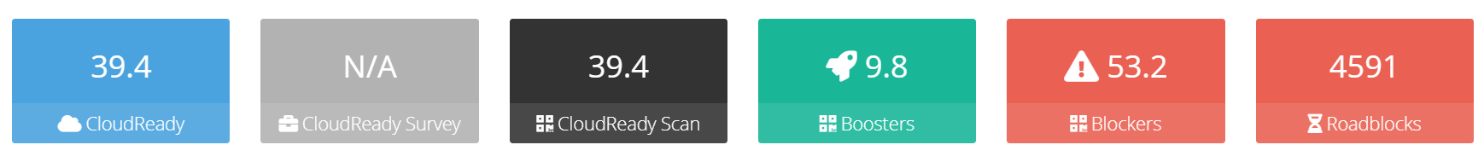
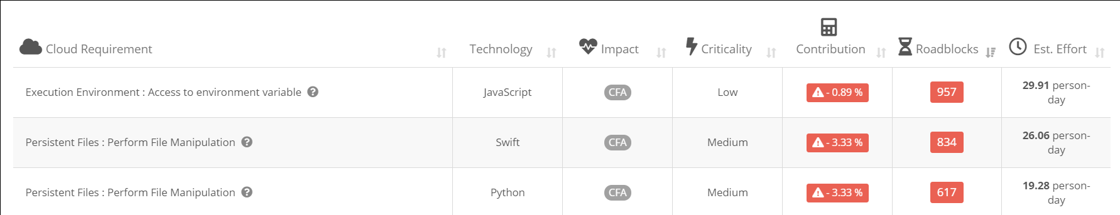
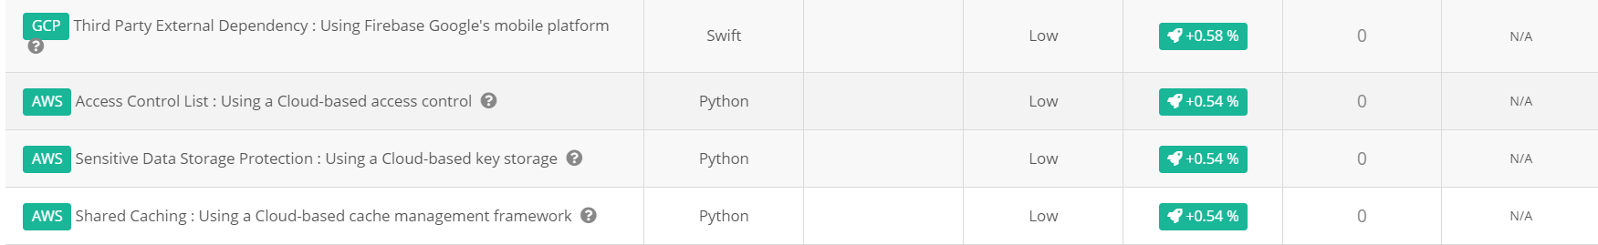
{app1_name} Assessment for cloud compliance [PaaS]
Pending
Cloud Migration Blockers
Sample Image
Full list of Cloud Blockers & Boosters
(Double-click to open)
Cloud Migration Boosters
{app_per_page}

Slide 16
{app1_name} Stored procedure statistics and deep dive
Statistics
To be updated (Additional info when lot of stored procedures in app)
Number of stored procs: 2740
Total LoC for stored procs: 566,456 LoC
For each stored proc:
Complexity of stored procedures (number of code branches / if…then / loops / cursors / etc.) Done, cyclomatic complexity
Number of conditions Included in cyclomatic complexity
Number of loops Included in cyclomatic complexity
Lines of code (LOC)
Comments
Commented code
External calls to other tables / procs (how entangled is the procedure) fan-out
The number of artifacts referring this one fan-in
Pending
Stored Procedures details for {App_Name}
(Double click to open)
{app_per_page}

Slide 17
{app1_name} Stored Procedure complexity distribution
Explanation
2740 stored procedures were evaluated for cyclomatic complexity distribution.
Majority (97%) of the stored procedures have cyclomatic complexity of less than 50. When broken down further, it was seen than 96% have cyclomatic complexity of less than 25 and 95% have less than 15 which is a good sign.
Almost 50% of total cyclomatic complexity lies in 66 stored procedures (highlighted), review those first to reduce the complexity in medium term.
6% of cyclomatic complexity from just three procedures (the bottom 3) also are good candidate for breakdown.
Refer sheet in slide 24 for full list of stored procedures with statistics
Pending
Template (Additional info when lot of stored procedures in app)
Cyclomatic Complexity | Count of procedures | Sum of Cyclomatic complexity
1-50 | 2671 | 44.10%
51-100 | 22 | 7.41%
101-150 | 11 | 6.92%
151-200 | 12 | 9.89%
201-250 | 15 | 16.73%
251-300 | 6 | 7.46%
401-450 | 1 | 1.95%
501-550 | 1 | 2.60%
601-650 | 1 | 2.93%
Grand Total | 2740 | 100.00%
{app_per_page}

Slide 18
{app1_name} Stored Procedure size distribution
Explanation
64% of the volume of stored procedures is coming from smaller procedures (< 1, 000 LOC per procedure), which is good.
Nearly 10% of the volume is from 13 stored procedures (having LOC > 3,000) are the review candidates and an opportunity if we can break them down first.
Refer sheet in slide 24 for full list of stored procedures with statistics
Pending
To be updated (Additional info when lot of stored procedures in app)
Lines of code | Count of procedures | Sum of Number of lines of code
1-500 | 2547 | 52.66%
501-1000 | 99 | 11.65%
1001-1500 | 35 | 7.58%
1501-2000 | 18 | 5.55%
2001-2500 | 10 | 3.93%
2501-3000 | 18 | 8.74%
3001-3500 | 2 | 1.14%
3501-4000 | 3 | 1.97%
4001-4500 | 5 | 3.68%
4501-5000 | 1 | 0.81%
5501-6000 | 1 | 1.02%
7001-7500 | 1 | 1.28%
Grand Total | 2740 | 100.00%
{app_per_page}

Slide 19
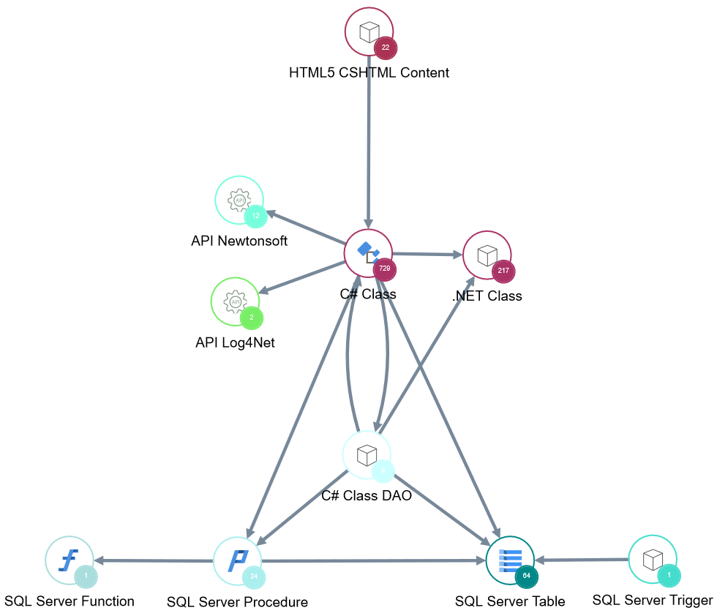
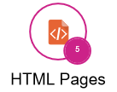
{app1_name} architecture and modernization readiness
Front / UI Technologies
Explanation
CONNECT_API is an interface application between EHRs and CERTIFY.
Application contains CSHTML/HTML pages (views, help pages, email templates).
Core is developed in C#/.NET and uses third-party libraries such as Log4Net (logging features) and Newtonsoft (JSON formatting features).
Application has a data access layer (DAO files) and uses the Entity framework and ADO.NET.
The persistence layer is composed of a relational SQL Server database which contains 64 tables, 34 stored procedures, 1 function and 1 trigger.
Key takeaways: no architecture issues. Using an abstraction layer to access the database is a good practice as it is database-agnostic and therefore makes the application more portable and more adaptable to changes.
Pending
Core
Sample Image
Data Access Layer
Persistence
{app_per_page}

Slide 20
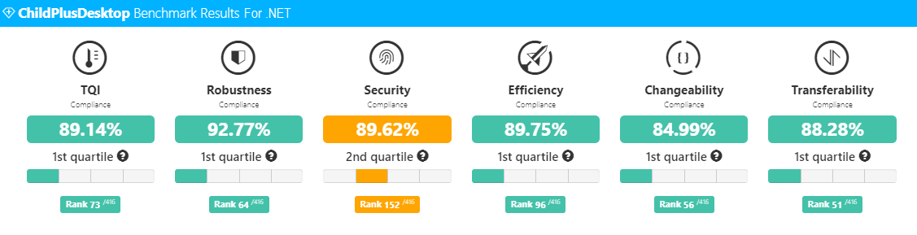
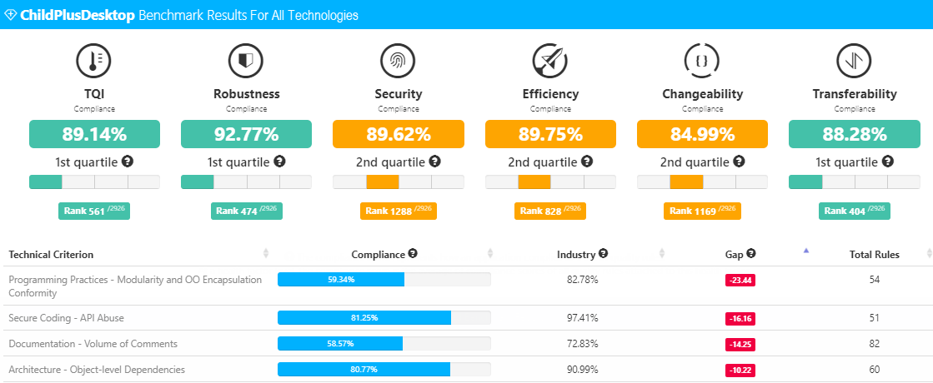
{app1_name} Peer Benchmark against apps of all technologies
Percentage compliance for .NET technology
Sample Image
Looking at the overall software health (TQI), application compared well against other applications it was benchmarked against.
The Security health factor is in the second quartile and should be addressed. The remaining two health factors are both good in the first quartile.
Pending
Percentage compliance for all technologies
Looking at the overall software health (TQI), application compared well against other applications it was benchmarked against.
Security, Efficiency and Changeability health factors are all in the second quartile and should be addressed. The remaining two health factors are both good in the first quartile.
Looking at the breakdown by technical criteria, “Programming Practices – Modularity and OO Encapsulation” category is where the application lags the most indicating some stability deficiencies.
Sample Image
{app_per_page}

Slide 21
{app1_name} has good compliance with ISO-5055
ISO-5055 |  | Violations
xxxxxxxxxxxxxxxxxxxxxxx | xxxxxxxxxxxxxxxxxxxxxxx | ###
ISO 5055
ISO 5055 SECURITY
ISO 5055
RELIABILITY
{app1_grade_ISO}
{app1_grade_ISO_SEC}
{app1_grade_ISO_REL}
ISO 5055 EFFICIENCY
ISO 5055
MAINTAINABILITY
{app1_grade_ISO_EFF}
{app1_grade_ISO_MAINT}
Pending
Summary
The measures in ISO 5055 standard were calculated from detecting and counting violations of good architectural and coding practices in the source code that could result in unacceptable operational risks or excessive costs.
Compliance score of {app1_grade_ISO} out of 4 is a good score. More than 90% of ISO 5055 violations in Voice are related to application maintainability which provide an opportunity to reduce ongoing maintenance cost. There are several violations related to security, production reliability and efficiency that should be reviewed.
The number of violations across ISO 5055 categories can be fixed with low-moderate effort, see full report for individual violations.
Refer https://technologies.castsoftware.com/rules for standards and rule documentation
Full Report
(Double-click to open)
1
2
3
4
1
Very high risk
2
High risk
3
Medium risk
4
Low risk
{app_per_page}

